Slide 1
Mine Detonating Sphere-bot
ROCO504
Preliminary Design Review
Charlie Freestone & Becky Harding

Slide 2
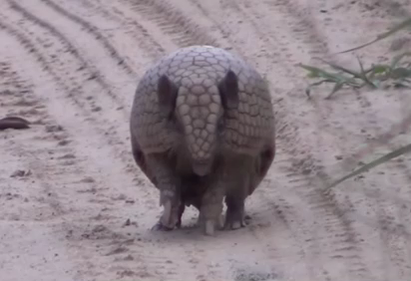
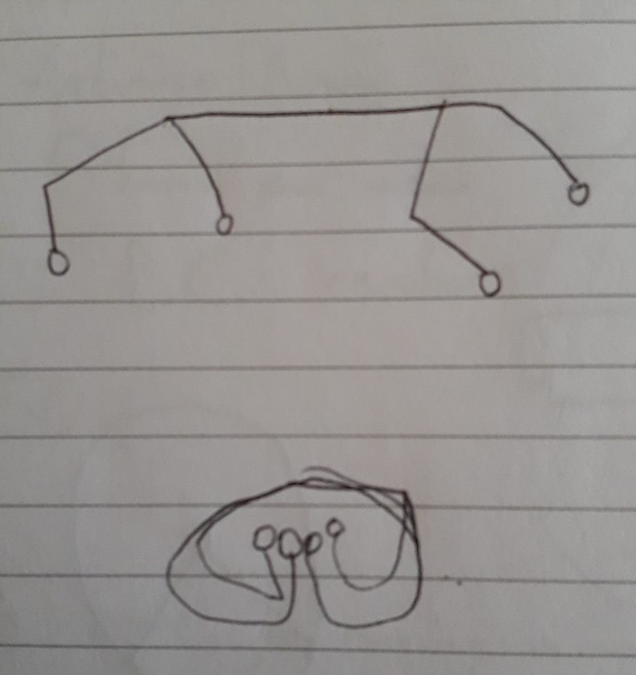
Background
Original Idea
Sketch
Armadillo https://www.youtube.com/watch?v=-x71UlnYVEU&feature=youtu.be

Slide 3
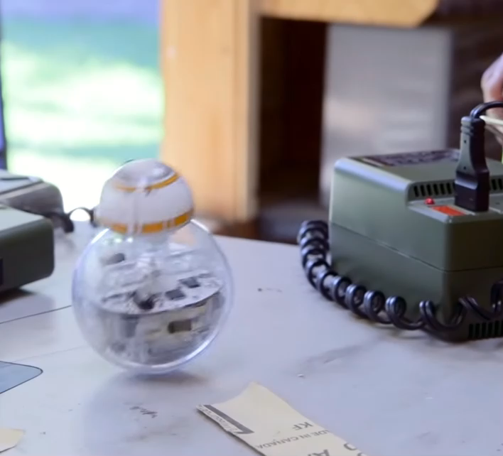
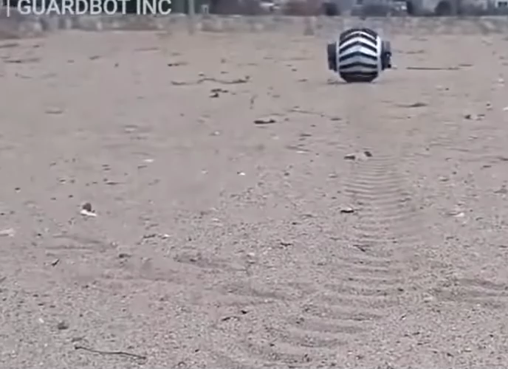
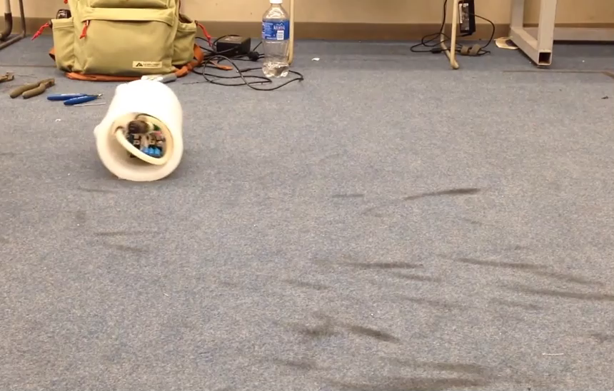
INSPIRATIONS
BB-8
Guardbot
Silicon Roll
https://www.youtube.com/watch?v=tgnhXmkydvY
https://www.youtube.com/watch?v=ar-YCHQK4ew
https://www.youtube.com/watch?v=5FHtcR78GA0

Slide 4
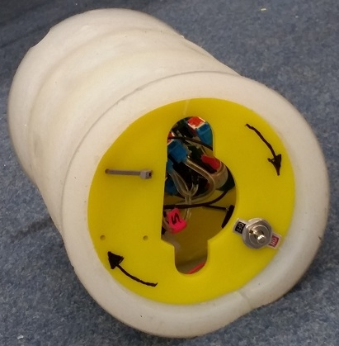
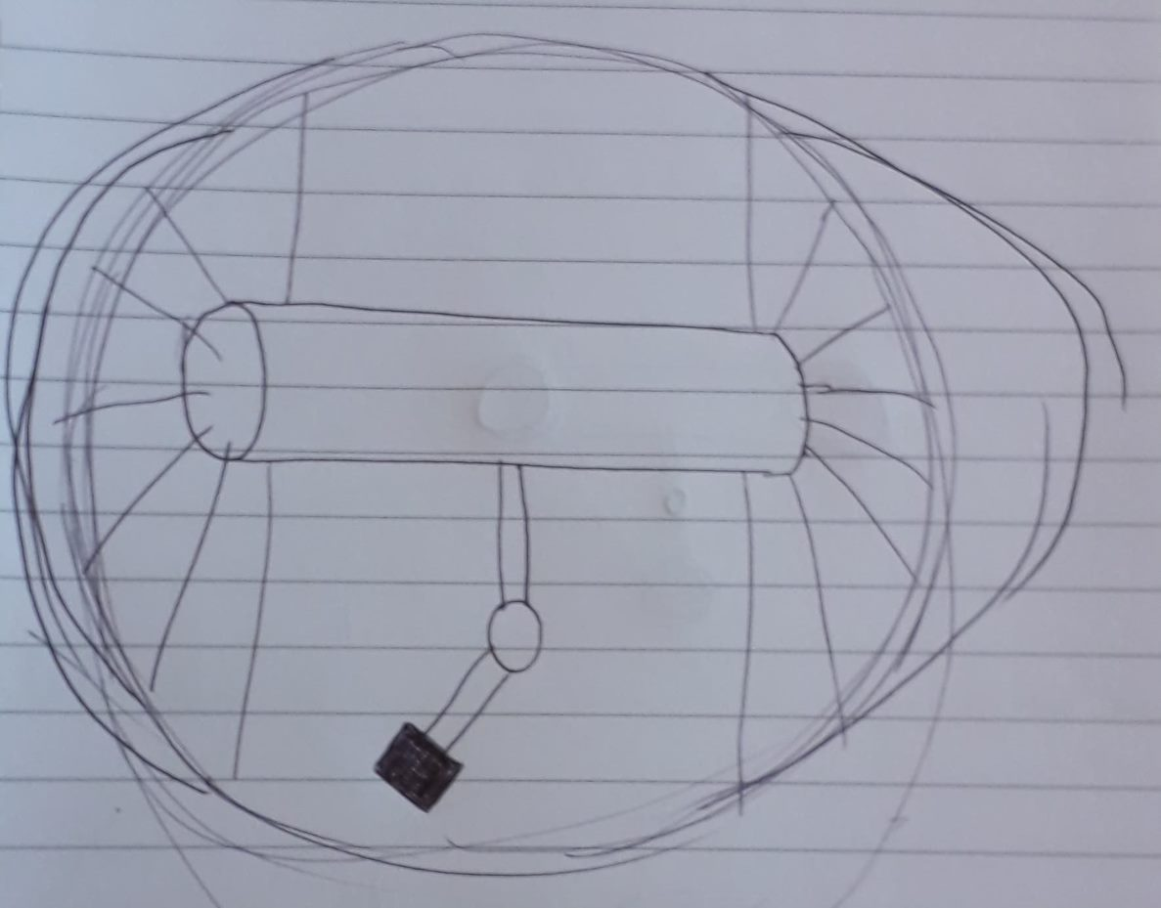
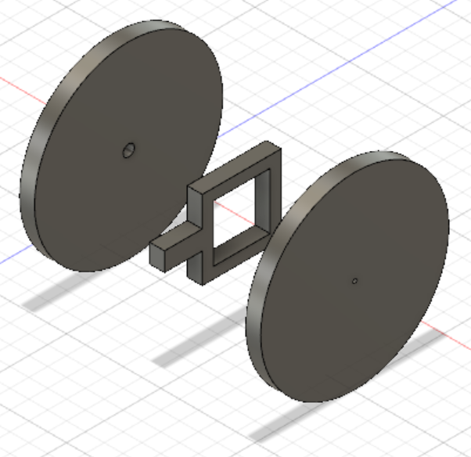
Developing Idea
Three Choices

Slide 5
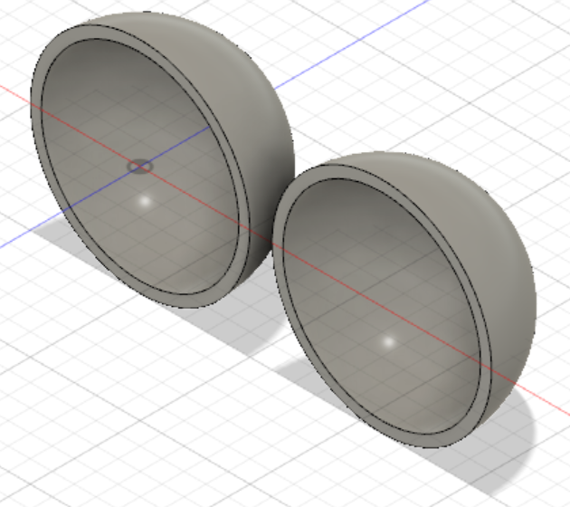
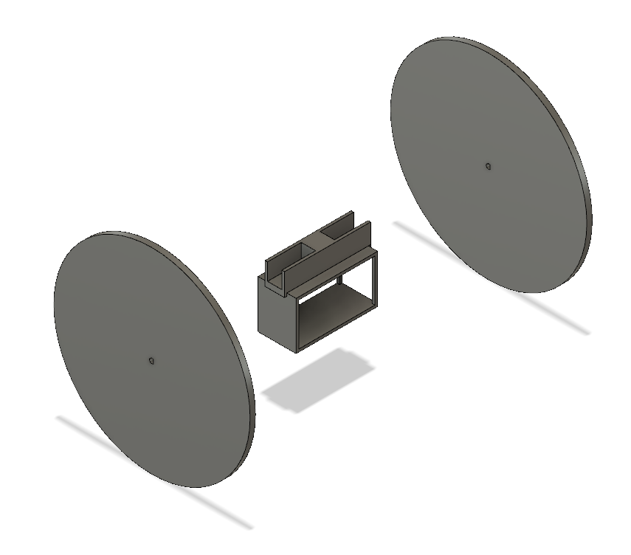
Prototype

Slide 6
PENDULUM IDEA

Slide 7
GANTT CHART
SMALL GROUP

Slide 8
END

